Slide 1
Acceleration and Accelerated Motion
Prepared by Chris Chiaverina

Slide 2
Chapter Contents
3.1 Acceleration
3.2 Motion with Constant Acceleration (Kinematic Equations)
3.3 Velocity-Time Graphs with Constant Acceleration
3.4 Free Fall

Slide 3
3.1. Acceleration
Acceleration is the rate at which velocity changes with time.
The velocity changes
when the speed of an object changes.
when the direction of motion changes.
Therefore, acceleration occurs when there is a change in speed, a change in direction, or a change in both speed and direction.

Slide 4
Acceleration
Example: A cyclist accelerates by increasing his speed 2 m/s every second. After 1 second his speed is 2 m/s, after 2 seconds his speed is 4 m/s, and so on.

Slide 6
The Human Body is an Acceleration Detector
While the human body cannot detect constant velocity, it can sense acceleration.
Passengers in a plane cannot detect constant velocity.
You can feel the plane speeding up or slowing down to land.

Slide 7
Definition of Acceleration
Average acceleration of an object is the change in its velocity divided by the change in time.
Stated mathematically, the definition of average acceleration a_{av} is

Slide 8
Units of Acceleration
The dimensions of average acceleration are the dimensions of velocity per time or (meters per second) per second. That is,
Written symbolically as m/s², the units of average acceleration are expressed as "meters per second squared."

Slide 10
Acceleration can change with time or be constant
Imagine you are at a stoplight and it changes to green. Your car increases its velocity and you can feel its acceleration. However; your car will slow down eventually to avoid receiving a speeding ticket.
We refer to the acceleration of an object at a given instant of time as the instantaneous acceleration.
Most of the situations in this book involve objects that experience constant accelerations. ( where the accelerations are the same at every instant in time.

Slide 11
What does this V-T Graph look like?

Slide 12
Acceleration can be determined graphically
What information does the slope of a Velocity vs. Time Graph tell us?
It gives us info
about an object’s acceleration.
The velocity is increasing but the acceleration remains constant.

Slide 13
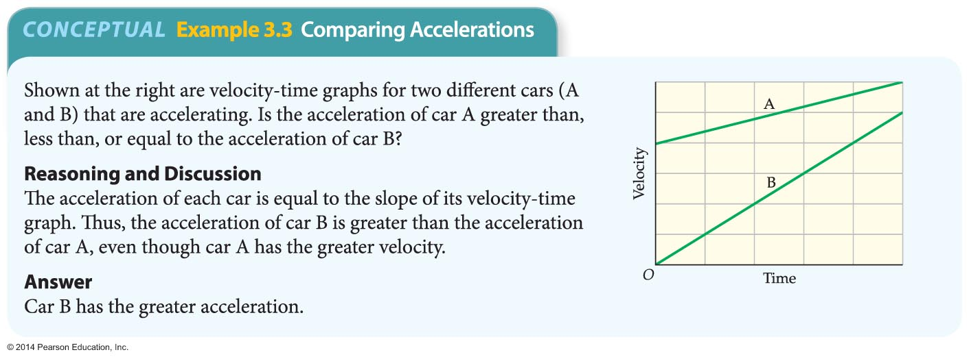
Which car has the greater acceleration?

Slide 14
Speed increases or decreases depending on positive or negative velocity and acceleration.

Slide 15
3.2 Motion with Constant Acceleration

Slide 16
The Big “4” Kinematic Equations
The kinematic equations are a set of four equations that can be utilized to predict unknown information about an object's motion if other information is known.
The equations can be utilized for any motion that can be described as being either a constant velocity motion (an acceleration of 0 m/s/s) or a constant acceleration motion.
They can never be used over any time period during which the acceleration is changing
1. X_{f} = X_{i} +.5(V_{i} + V_{f}) t
2. X_{f} = X_{i} + V_{i}t + .5at²
3. V_{f} = V_{i} + at
4. V_{f}² = V_{i}² + 2aΔx

Slide 21
3.3 Velocity -Time Graphs
The slope of a V-T graph is equal to the object’s acceleration in that segment.
change in y
slope =
50.
change in x
40.
velocity (m/s)
(50. m/s – 10. m/s
30.
slope =
(3.0 s – 0 s)
20.
10.
(40. m/s)
slope =
(3.0 s)
1.0
2.0
3.0
4.0
time (s)
slope = 13 m/s²

Slide 22
Velocity-Time Graphs
This Graph shows an object moving with a constant positive velocity, but No Acceleration
+
Object is moving with a constant velocity in the (+) direction
velocity (m/s)
time (s)
-

Slide 23
Velocity-Time Graphs
This graph shows an object moving with a constant negative velocity, but no acceleration
+
Object is moving with a constant velocity in (-) direction
velocity (m/s)
time (s)
-

Slide 24
Velocity-Time Graphs
This graph shows an object not moving.
+
Object is at rest
velocity (m/s)
time (s)
-

Slide 25
Since Acceleration is a vector, how do we determine the direction of acceleration on a graph?
Acceleration can be positive or negative.
Acceleration is a vector that points in the same direction as the change in velocity.
Therefore; the direction of acceleration is determined by the direction of the slope.

Slide 26
Velocity-Time Graphs
V-T Graphs that show Positive Accelerations
+
+
velocity (m/s)
velocity (m/s)
time (s)
time (s)
The direction of the slope indicates whether acceleration is positive or negative:
This object is speeding up in the positive direction
This object has a positive slope; therefore a positive acceleration.
This object is slowing down in the negative direction
-
-

Slide 27
Velocity-Time Graphs
V-T graphs that show Negative Accelerations
+
+
velocity (m/s)
time (s)
velocity (m/s)
time (s)
This object has a negative slope; therefore acceleration will be negative.
Object is slowing down in the positive direction
This object has a negative slope; therefore acceleration will be negative.
object is speeding up in the negative direction
-
-

Slide 28
Velocity-Time Graphs SUMMARY
A velocity-time (V-T) graph shows an object’s velocity as a function of time.
A horizontal line = constant velocity.
A straight sloped line = constant acceleration.
Acceleration = change in velocity over time.
Positive slope = positive acceleration.
Not necessarily speeding up!
Negative slope = negative acceleration.
Not necessarily slowing down!

Slide 29
Checkpoint
Consider the graph at the right. The object whose motion is represented by this graph is ... (include all that are true):
A. moving with positive velocity.
B. moving with a constant velocity.
C. moving with a negative velocity.
D. slowing down.
E. changing directions.
F. speeding up.
G. moving with a positive acceleration.
H. moving with a negative acceleration

Slide 30
ANSWER
A,D, and H

