Slide 1
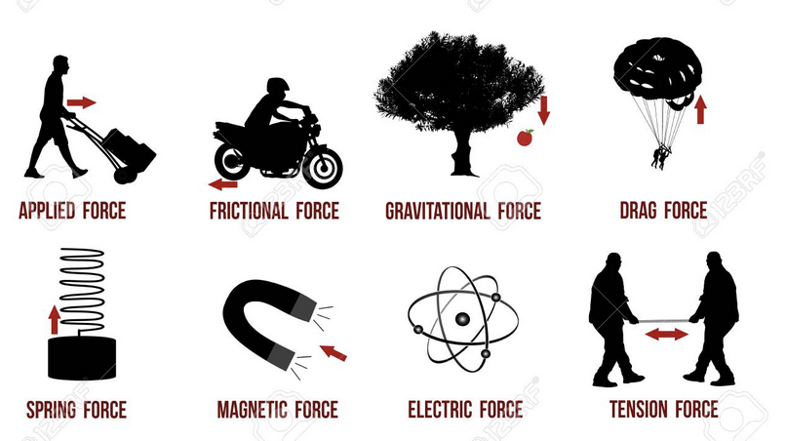
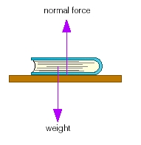
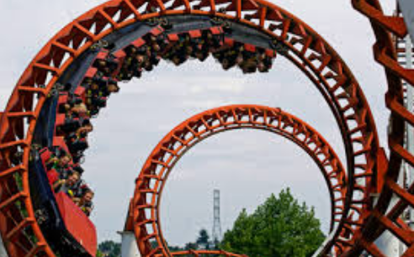
Forces and Free Body Diagrams

Slide 2
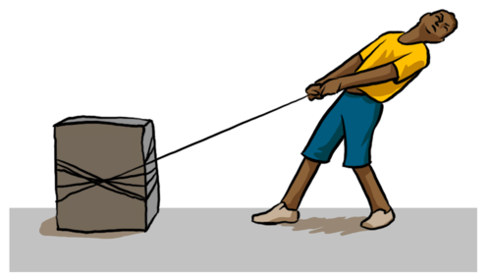
FORCE
Force is the push or pull that causes objects to move, change direction, slow down, speed up, or stop.

Slide 4
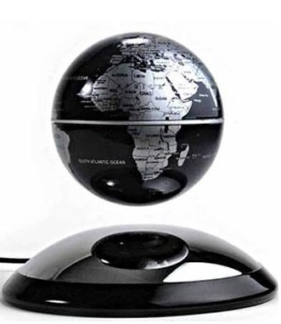
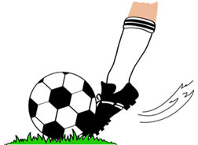
Two types of FORCES
There are two types of force; “contact force” and “at a distance force.”
CONTACT FORCE (CF): the force acts upon the target once two objects come into direct contact.
Noncontact Force (NCF): the force works upon the target without two objects coming into direct contact.
Contact force: The foot will move the ball once the foot contact with the ball is made.
Non-contact force: The magnet causing the globe to levitate does not need to be in direct contact with the globe.

Slide 5
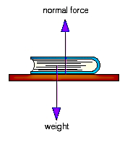
NORMAL FORCE
Type of force
Force symbol
CF
F_{N}
Normal force is the support force exerted upon an object that is in contact with a stable object.
Normal force normally presses on the object from below.
For example normal force comes a table unto the book.
Normal force is always perpendicular to the surface.

Slide 6
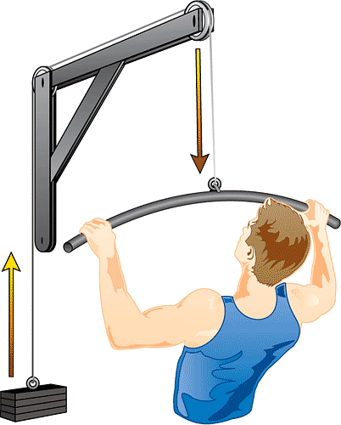
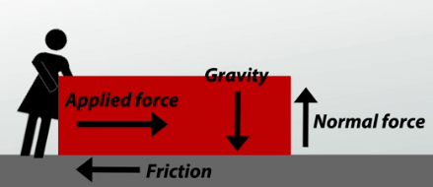
APPLIED FORCE
Type of force
Force symbol
CF
F_{A}
Applied force is the force that is applied to an object by another object or person pushing or pulling it.

Slide 7
FRICTIONAL FORCE
Type of force
Force symbol
CF
F_{f}
Frictional force is the force that works opposite the applied force.
When sliding an object across carpet it is the frictional force that makes it difficult to move an object.
Moving an object across a concrete floor will be easier.
Moving an object over a surface of ice will be the easiest because there is no frictional force.

Slide 8
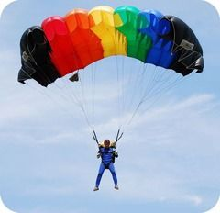
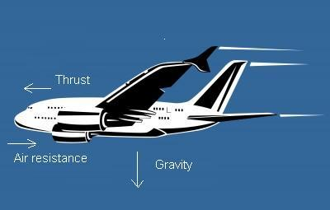
AIR RESISTANCE FORCE
Type of force
Force symbol
CF
F_{air}
Air resistance force is the force that moves in the opposite direction of an object moving through the air.
Air resistance moves in the opposite direction of the object in motion.
Air resistance force pushes up into the parachute while the man falls down.

Slide 9
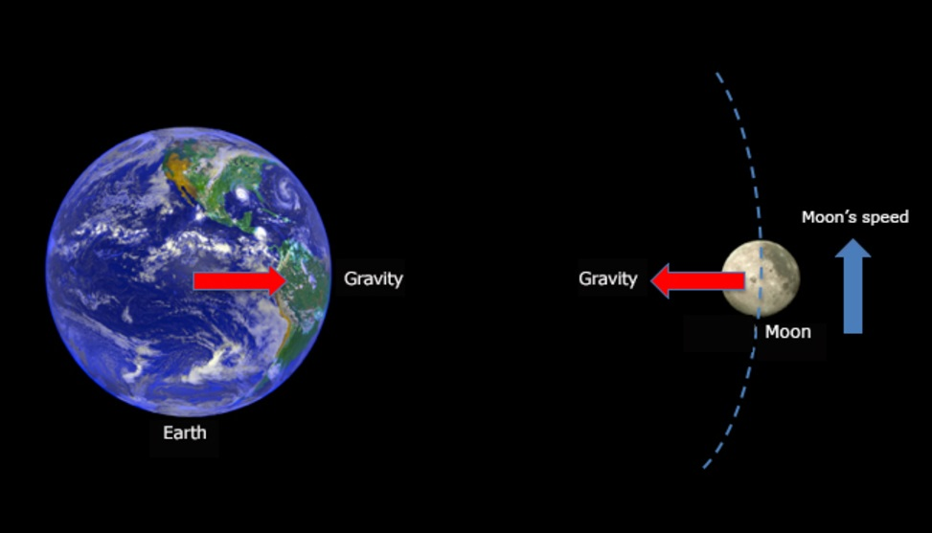
GRAVITATIONAL FORCE
Type of force
Force symbol
F_{g}
NCF
Force which keeps planets, stars and moons in orbit. Force which keeps people and things stable on the earth’s surface.
The moons gravity pulls the earth to the moon and causes the tides to rise and fall. While the earth’s gravity pulls the moon to earth keeping it in orbit around earth.

Slide 10
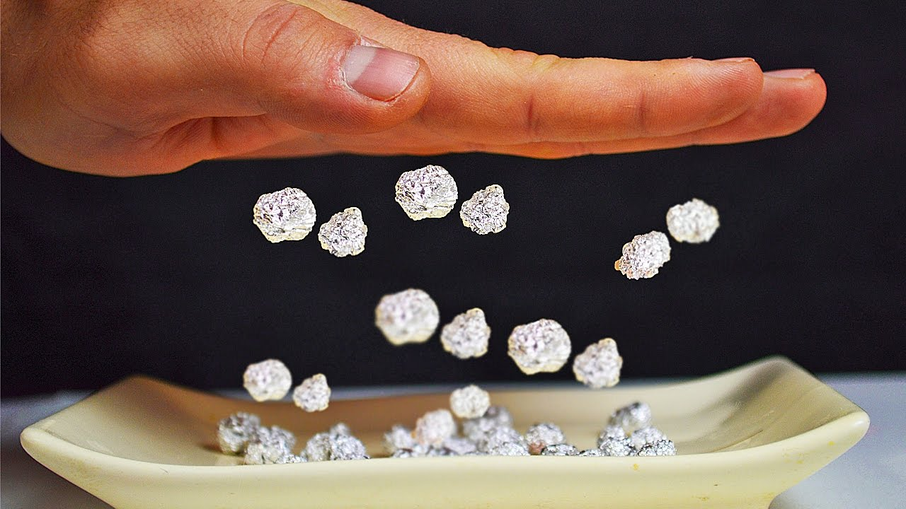
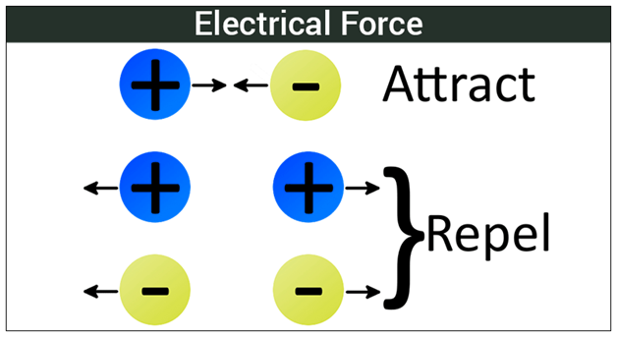
ELECTRICAL FORCE
Type of force
Force symbol
F_{E}
NCF
Force created through the positive and negative ions which create electricity and static electricity.

Slide 11
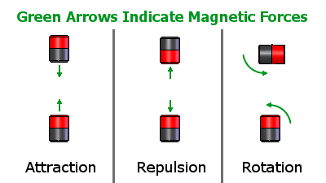
MAGENTIC FORCE
Type of force
Force symbol
F_{mag}
NCF
The attraction or repulsion between charged objects or particles.
Magnets pull to each other when poles are opposite.
Magnets push away from each other when the poles are alike.

Slide 12
Free- Body Diagrams

Slide 13
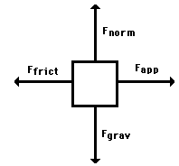
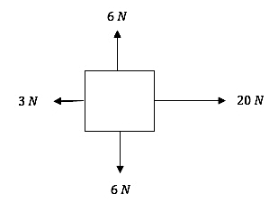
Free Body Diagram
Free body diagrams show size and direction of forces acting on an object, using vectors (arrows) and Newtons.
Free body diagrams are used to understand which directions the forces are acting upon an object.
Free body diagrams can help determine what direction the object is moving in.

Slide 14
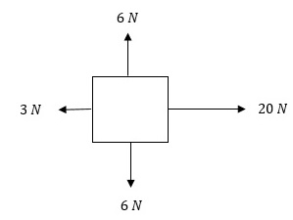
Vectors
The vectors illustrate which direction the force is pushing or pulling an object using arrows.
The vectors are labeled by the type of force it represents or the quantity of force being exerted.
(The red arrows are pointing to the vectors.)
Which vector is the strongest? What direction would the square be moving in?
20N is the strongest vector and the object is moving rightward. The net force is 17N right.

Slide 15
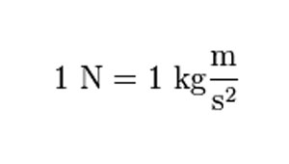
Newton
The unit of measurement used to measure force is called a Newton.

Slide 16
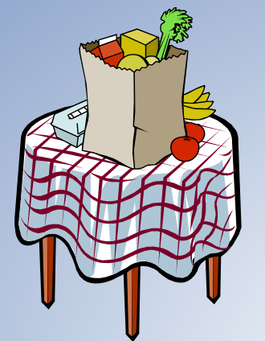
Constructing a free- body diagram
Let’s look at an example:
A grocery bag rests on an object.
1. Determine the forces acting on the object.
2. Determine the direction of the forces acting on the object.
3. Draw a box to represent the object.
4. Draw arrows to represent the forces (the longer the arrow represents the greater the force).
5. Label the forces

Slide 17
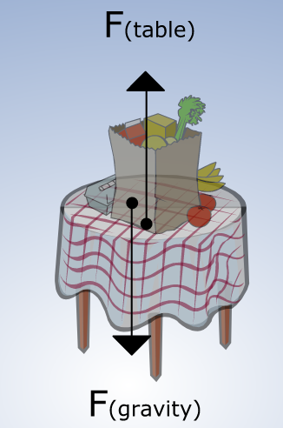
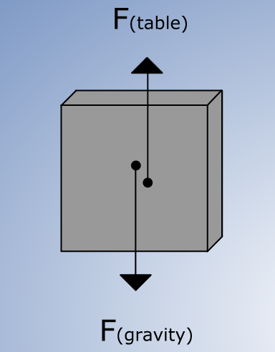
A grocery bag rests on an object.
The force of gravity acts on the bag.
The direction is downward.
The force of the table holds up the bag.
The direction is upward.

Slide 18
Constant Velocity
Balanced forces.
Could be at rest or moving left, right, up or down

Slide 19
Interpreting motion
Which of these objects could be at rest?
Which of these objects could be moving with a constant velocity?
Which of these objects could be moving right? Left?
Which of these object are accelerating?

Slide 20
Interpreting motion
Which of these objects could be at rest? A and C
Which of these objects could be moving with a constant velocity? A and C
Which of these objects could be moving right? Left? B (left)
Which of these object are accelerating? B and D

Slide 21
Practice interpreting a Free-Body Diagram
Describe what is happening in each of the following situations.

Slide 22
Practice interpreting a Free-Body Diagram
A. The object is stationary (not moving because the opposing forces cancel one another out.
B. Object is moving to the right because the right force is 5N more than the left force (net force is 5N right) and the other two opposing forces cancel one another out.
C. Object is stationary.
D. Object is moving to the right.

Slide 23
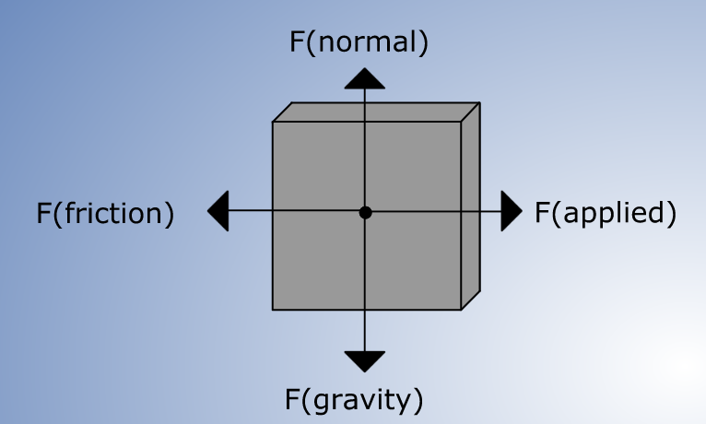
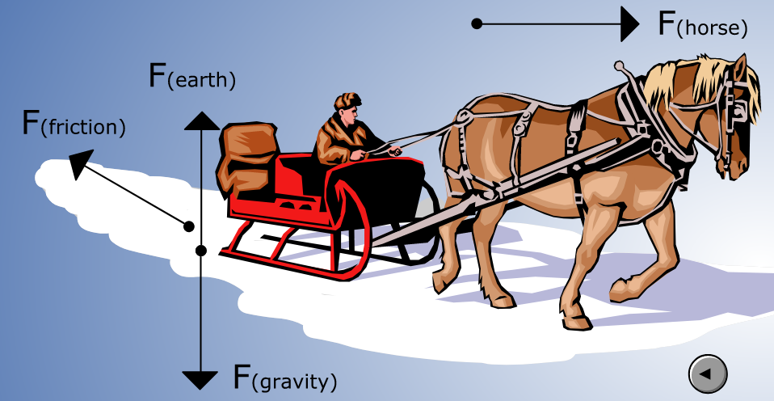
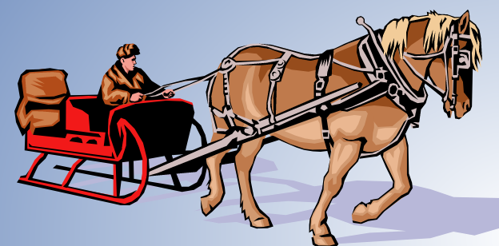
A horse pulls a sleigh to the right. Consider the frictional forces. Observe the forces acting on the sleigh and draw a free body diagram.
The horse is pulling right.
The Friction of the snow is pushing to the left.
The force of the surface of the earth (covered with snow) is pushing upward.
The force of gravity on the sleigh is pulling downward.

