Slide 1
Welcome!
The Topic For Today Is…

Slide 2
Distance Learning Review
Express Yourself | Totally Terms | Equal ≠ Inequality | Goofy Graphs And Tables | Random
1 point | 1 point | 1 point | 1 point | 1 point
2 points | 2 points | 2 points | 2 points | 2 points
3 points | 3 points | 3 points | 3 points | 3 points
4 points | 4 points | 4 points | 4 points | 4 points
5 points | 5 points | 5 points | 5 points | 5 points
Final Trivia Question

Slide 3
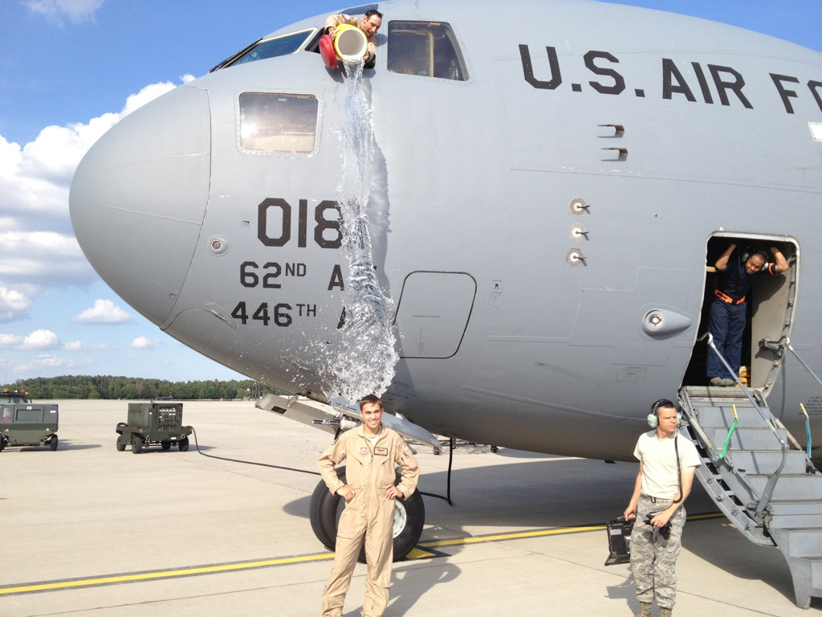
Expressions: 1 pt
Question:
x • x • 8 • 8 • 8
simplify using exponents
Answer: x² • 8³
Back

Slide 4
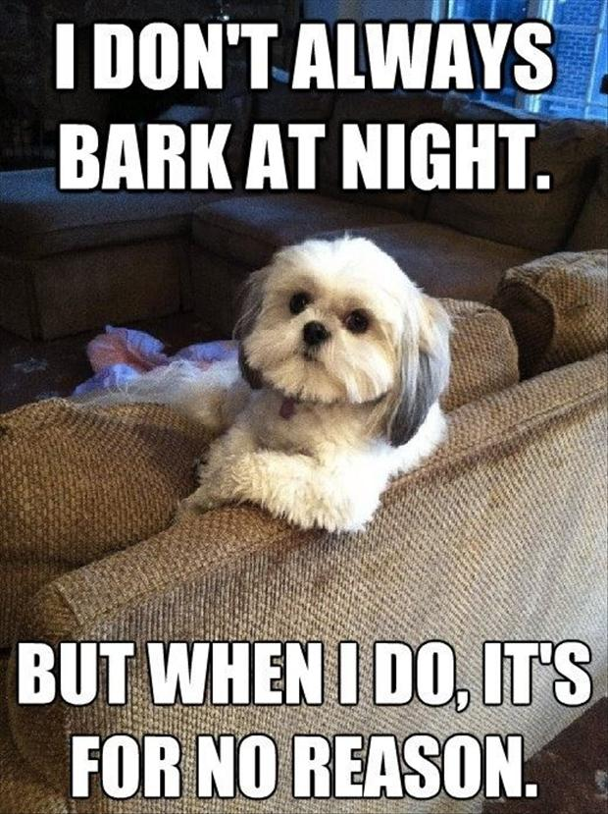
Expressions : 2 pts
Question:
4³ =
Answer: 64
Back

Slide 5
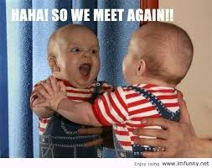
Expressions : 3 pts
Question:
Simplify x + x + x + x
Answer:
4x
Back

Slide 6
Expressions : 4 pts
Question:
A number decreased by 8 written as an expression
Answer:
n - 8
Back

Slide 7
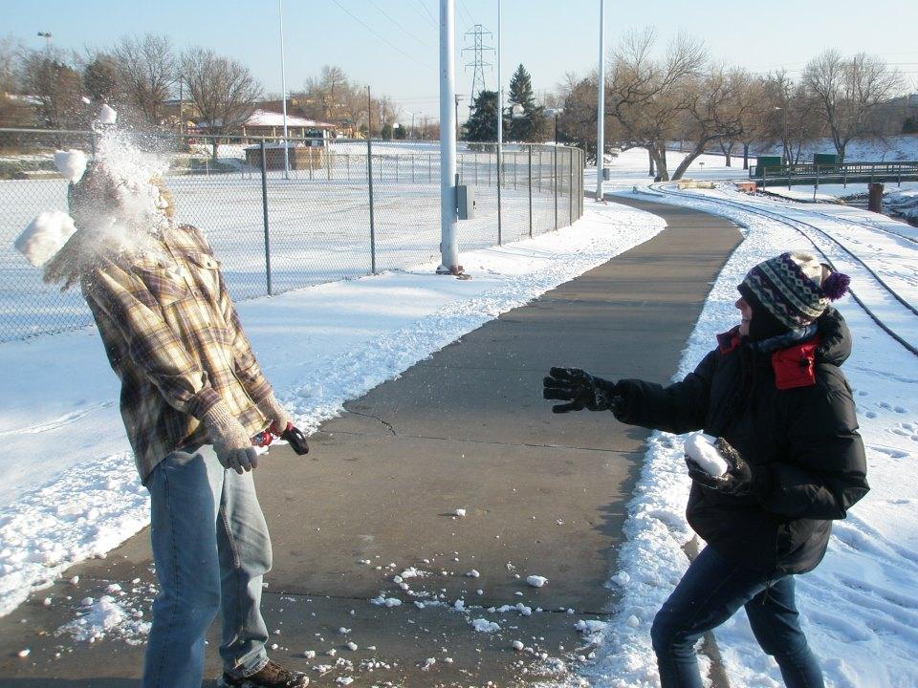
Expressions: 5 pts
Question:
The cost of putt-putt golf is $6 per person and you have a group discount coupon for $5. Write this as an expression using p as the variable for person.
Answer:
6p - 5
Back

Slide 8
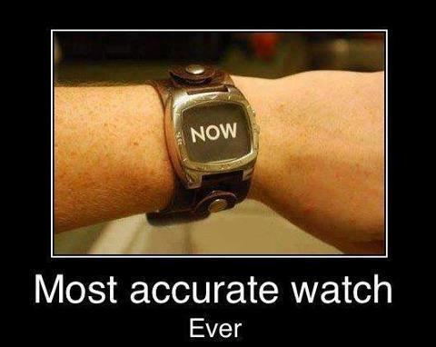
Terms: 1 pt
Question:
Identify the coefficient:
8³ + 5x + 9 = 82
Answer: 5
Back

Slide 9
Terms: 2 pts
Question:
Simplify:
2(3x + 5)
Answer:
6x + 10
Back

Slide 10
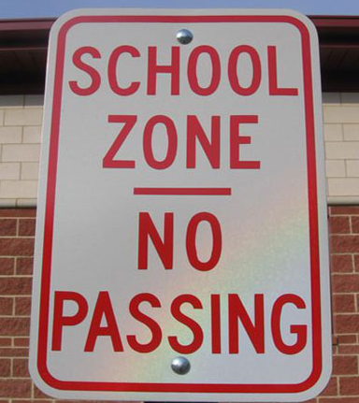
Terms: 3 pts
Question:
Express this model using distributive property:
2
y
4
Answer: 8 + 4y
Back

Slide 11
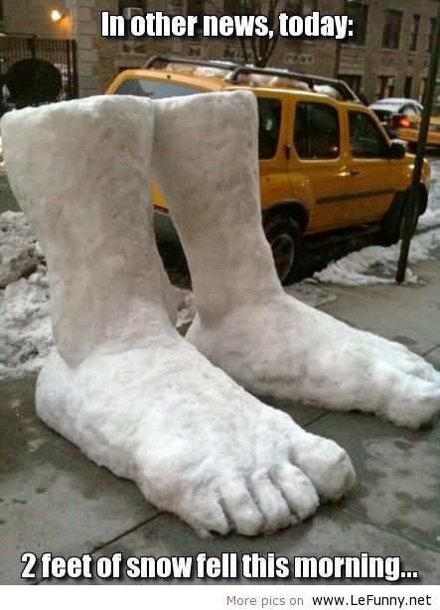
Terms: 4 pts
Question:
Combine like terms:
3ab + 5b + 6ab + 6b²
Answer:
9ab + 5b + 6b²
Back

Slide 12
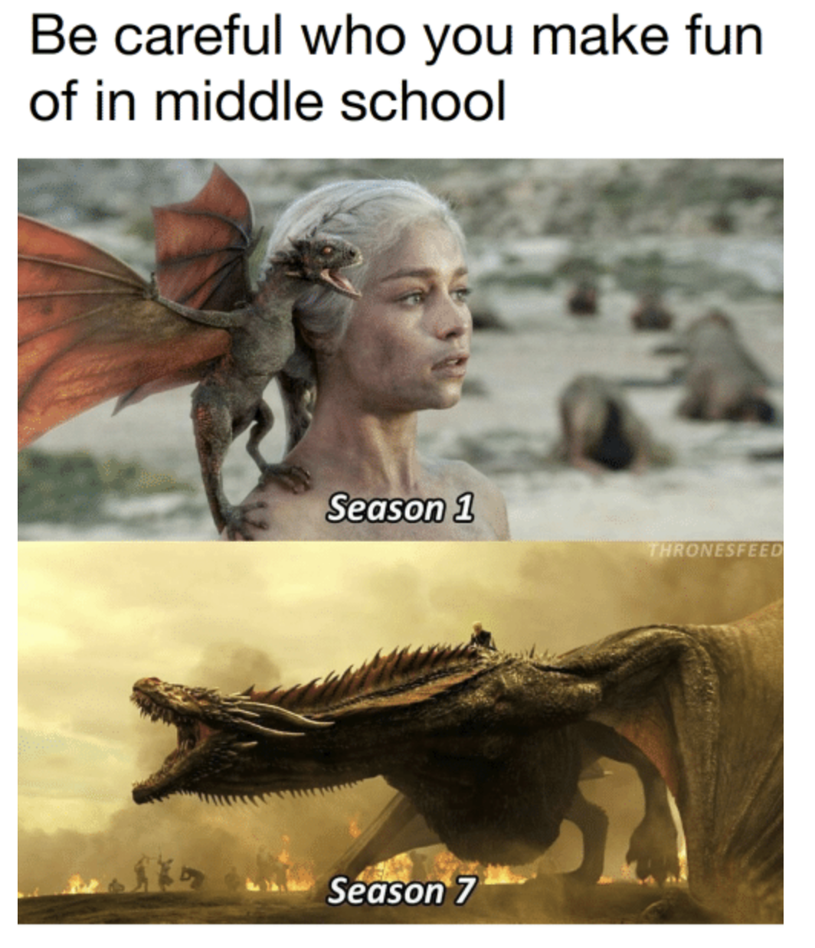
Terms: 5 pts
Question:
The edge of a cube is 5cm. What is the volume?
V = s³
Answer:
125 cm³
Back

Slide 13
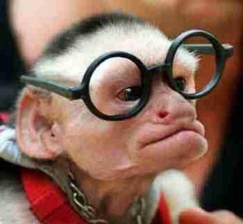
= & ≠ : 1 pt
Question:
Solve if x = 4
6x - x²
Answer:
8
Back

Slide 14
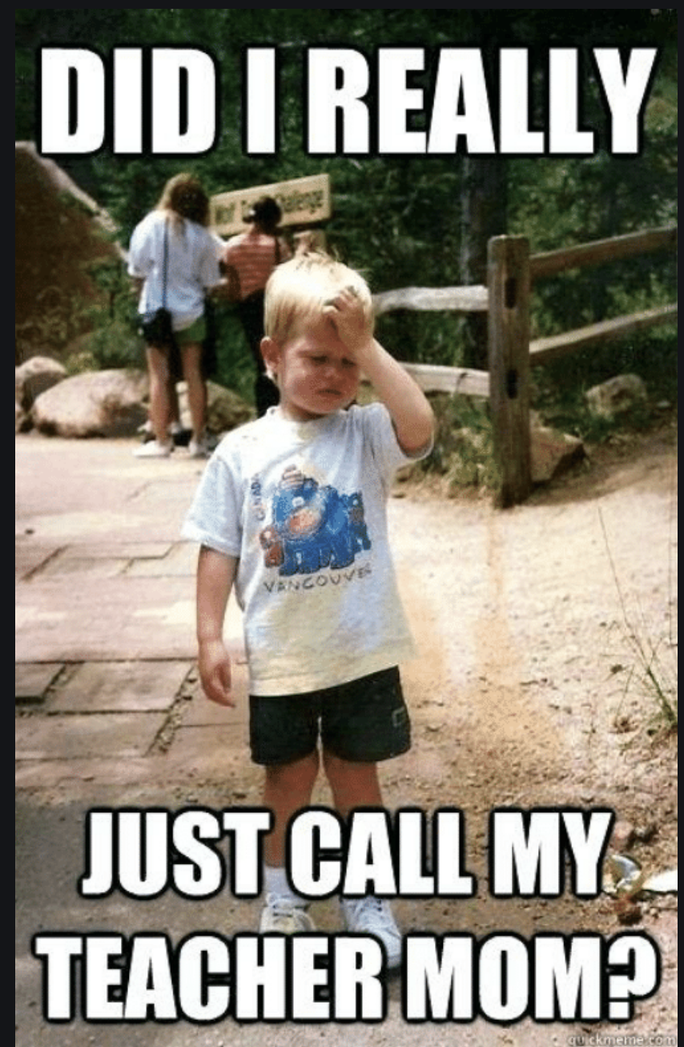
= & ≠ : 2 pts
Question:
Solve for y
9 + y = 27
Answer:
y = 18
Back

Slide 15
= & ≠ : 3 pts
Question:
Solve for a
6a = 78
Answer:
a = 13
Back

Slide 16
= & ≠ : 4 pts
Question:
Solve for x
18x > 72
Answer:
x > 4
Back

Slide 17
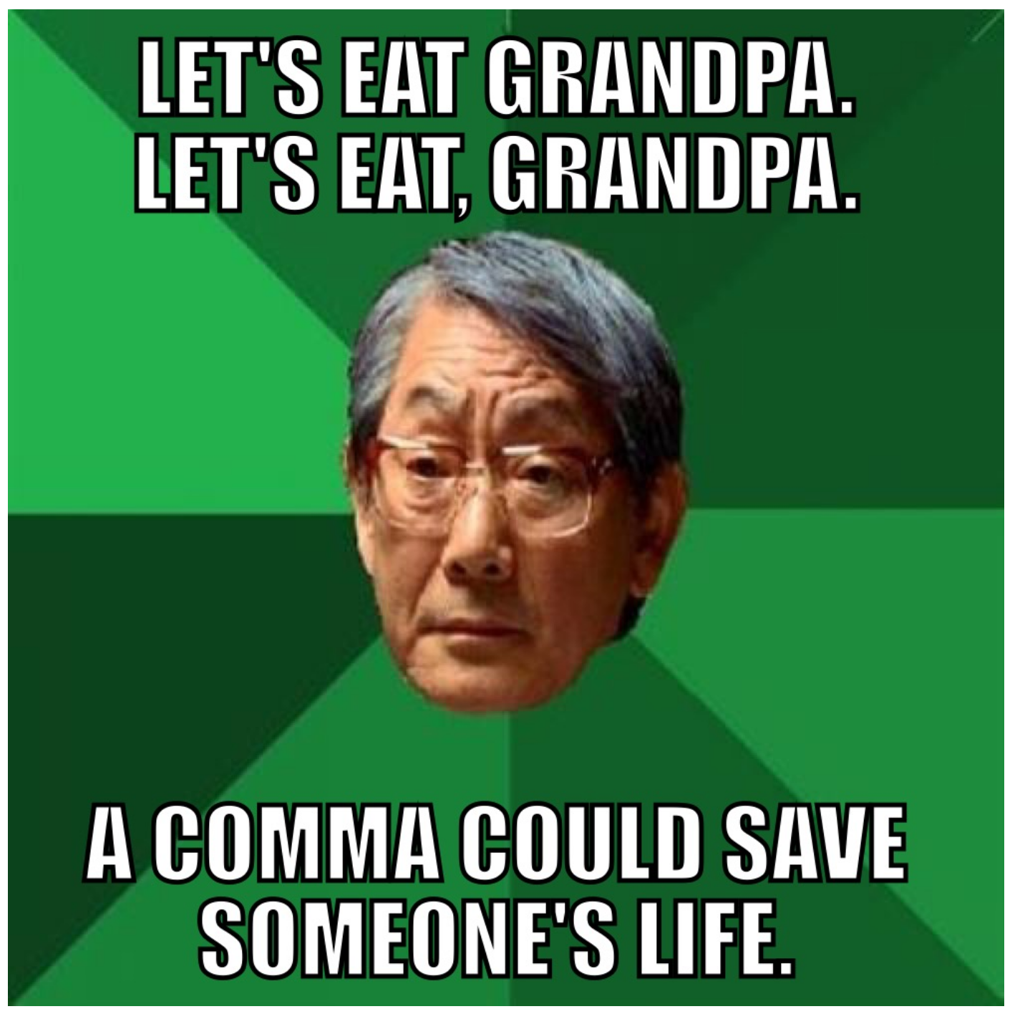
= & ≠ : 5 pts
Question:
Jackson gets paid monthly, m, and gets paid a $500 bonus once per year. What is his annual salary if he earns $1,200 per month?
Answer:12m + 500 = $14,900
Back

Slide 18
Graphs: 1 pts
Question:
Solve for x.
Quarts | 4 | 8 | 12 | x
Gallons | 1 | 2 | 3 | 4
Answer:
x = 16
Back

Slide 19
Graphs: 2 pts
Question:
Solve for the missing y. y = 3x + 2
x | 2 | 5 | 7 | 10
y | 8 | 17 | 23 | ?
Answer:
32
Back

Slide 20
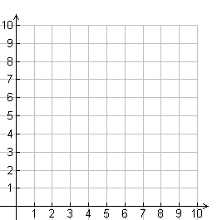
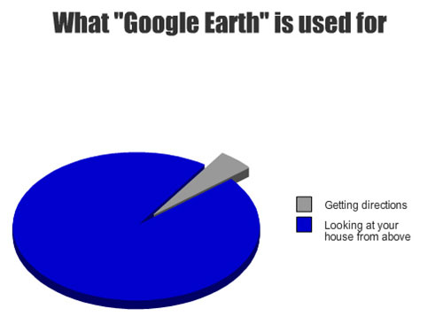
Graphs: 3 pts
Question:
If x is 9 what is y?
Answer:
2
Back

Slide 21
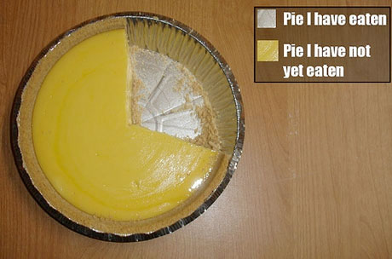
Graphs: 4 pts
Question:
The veterinarian charges $25 for an office visit and $30 a day to keep an animal overnight. What is the cost if your dog goes in for an office visit and has to stay for three nights? c = 30d +25
Answer:
$115
Back

Slide 22
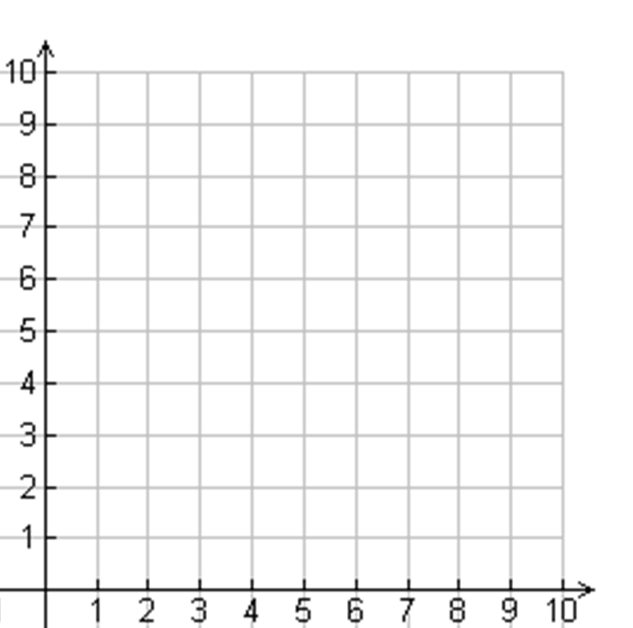
Graphs: 5 pts
Question:
What is the value of y when x is zero?
Answer:
3
Back

Slide 23
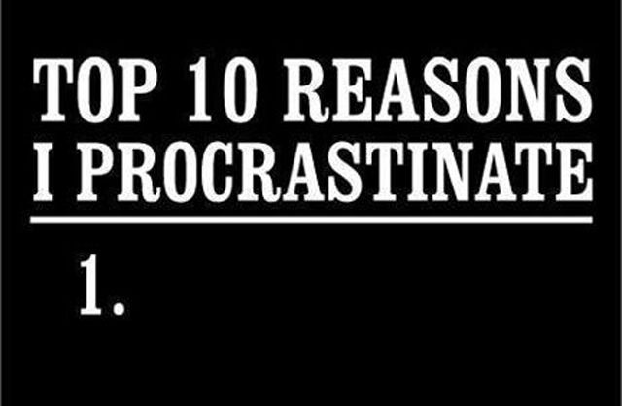
Random : 1 pt
Question:
If the ray represents x then what is the value of x?
Answer:
x ≤ 2
Back

Slide 24
Random : 2 pts
Question:
If the ray represents x then what is the value of x?
Answer:
x > 2
Back

Slide 25
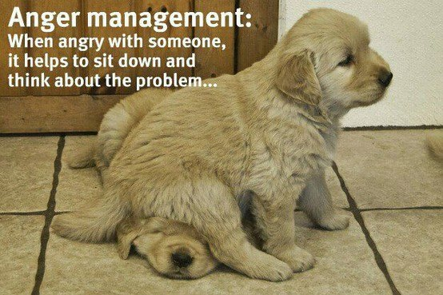
Random : 3 pts
Question:
Solve for y. 20.5y = 164
Answer:
y = 8
Back

Slide 26
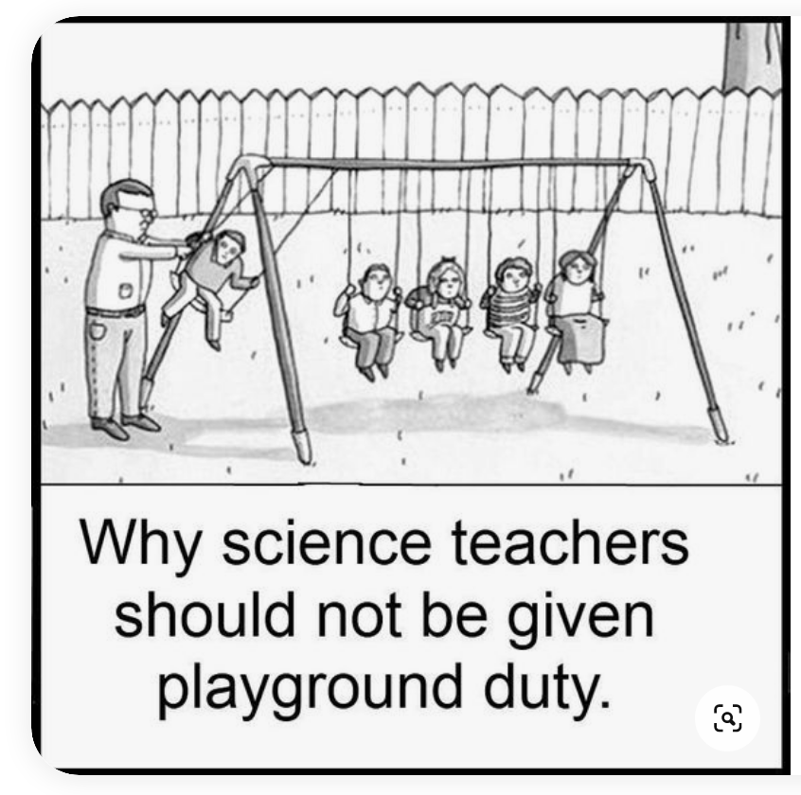
Random : 4 pts
Question:
Express 28 less than a number, n.
Answer:
n - 28
Back

Slide 27
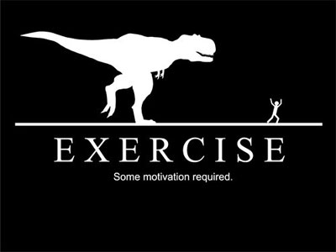
Random : 5 pts
Question:
What is the value of the expression when x = 6 and y = 7?
2x² + 9y
Answer:
135
Back

Slide 28
Final Jeopardy 1
Final Jeopardy 2
Final Jeopardy 3
Final Jeopardy 4
Topic: Memphis
Decide how many points your team is willing to risk.
If You get the Question right you win the points
If you get it wrong you lose the points!

Slide 29
Question:
Where does the name for the city of Memphis originate?
Answer: It was named after an ancient city on the Nile River in Egypt.
Back

Slide 30
Question:
This famous singer/songwriter went to middle school in Shelby Forest, near Millington.
Answer: Justin Timberlake
Back

Slide 31
Question:
Tennessee has more than 9,600 of these, more than any other state.
Answer: caves
Back

Slide 32
Question:
In 1879 Memphis lost its city charter due to what?
Answer: a yellow fever epidemic
Back

Slide 33
Answer Key
Express Yourself | Totally Terms | Equal ≠ Inequality | Goofy Graphs And Tables | Random
x² • 8³ | 5 | 8 | x = 16 | x ≤ 2
64 | 6x + 10 | y = 18 | 32 | x > 2
4x | 8 + 4y | a = 13 | 2 | y = 8
n - 8 | 9ab + 5b + 6b² | x > 4 | $115 | n - 28
6p - 5 | 125 cm² | $14,900 | 3 | 135
Final Trivia Question

